Slide 1
Business and Industrial Economics
Prof. Luca Grilli
Efficiency, Coordination and Economic Organization

Slide 2

Actors
Individuals
Economic Organizations
Transactions (inter and intra these 2 categories)

Slide 3
ECONOMIC ORGANIZATIONS (Milgrom and Roberts 1992)
Economic organizations are created-entities within and through which people interact to reach their goals.
The highest-level organization is the “Economy” as a whole; “Markets” (and the way transactions are governed, managed and carried out) are lower-level economic organizations; “Firms” and other formal entities (e.g. labor unions, government/regulatory agencies, associations, etc.) are economic organizations that are formed and interact with individuals in markets.

Slide 4
Inputs, Production, Outputs, and Consumption Form the Circular Flow of Economic Life (Samuelson and Nordhaus, 2001)
Industry i
Industry j
Supply of resources and products
Firm
Firm
Firm
Firm
Firm
Firm
Firm
Firm
Firm
Demand of products and resources (e.g. materials, capital goods, services)
Firm
Supply of resources (e.g. Labour, savings)
Demand for products (goods and services)
Supply of products
Demand for resources
Household
Household
Household
Household
Individual

Slide 5
Pareto efficiency
An allocation of resources A is inefficient if there is some other available allocation B that everyone concerned likes at least as A and that one person strictly prefers. In such a case A is Pareto dominated by B (B is Pareto superior to A) and it is clearly wasteful from a society point of view. Otherwise A is said to be Pareto efficient (or Pareto optimal).
Notice that to give all resources to a single insatiable and completely selfish individual would be efficient (ethics is not contemplated).
Moreover, there are typically many efficient allocations for a given collection of resources. Thus, the efficiency criterion may be weak on ethical grounds and as a predictor of outcomes.
But its predictive power is not totally absent: the Efficiency Principle

Slide 6
The efficiency principle
The efficiency principle: If people are able to bargain together effectively and can effectively implement and enforce their decisions, then the outcomes of economic activity will tend to be efficient (at least for the parties to the bargain).
Indeed, since efficient choices and allocations are less vulnerable, we should expect inefficient arrangements being supplanted over time, while efficient ones survive.

Slide 7
The Edgeworth Box and the gains from Trade
Two consumers, A and B.
Their endowments of goods 1 and 2 are
For example:
The total quantities available are
and
and
units of good 1
and
units of good 2.

Slide 8
Starting an Edgeworth Box

Slide 9
Starting an Edgeworth Box
Width =

Slide 10
Starting an Edgeworth Box
Height =
Width =

Slide 11
Starting an Edgeworth Box
Height =
The dimensions of the box are the quantities available of the goods.
The BOX includes all feasible allocations of the goods between the 2 consumers.
Of course including the before-trade allocation.
Width =

Slide 12
The Endowment Allocation
2
O_{B}
2
6
The endowment allocation
4
O_{A}
6
8

Slide 13
Other Feasible Allocations
denotes an allocation to consumer A.
denotes an allocation to consumer B.
An allocation is feasible if and only if
and

Slide 14
Feasible Reallocations
O_{B}
O_{A}

Slide 15
Questions
Which allocations will be blocked by one or both consumers?
Which allocations make both consumers better off?
Concept of preferences => difference curve

Slide 16
Adding Preferences to the Box
For consumer
A.
O_{A}

Slide 17
Adding Preferences to the Box
For consumer A.
More preferred
O_{A}

Slide 18
Adding Preferences to the Box
For consumer B.
O_{B}

Slide 19
Adding Preferences to the Box
For consumer B.
More preferred
O_{B}

Slide 20
Adding Preferences to the Box
For consumer B.
O_{B}
More preferred

Slide 21
The Endowment Allocation
2
O_{B}
2
6
The endowment allocation
4
O_{A}
6
8

Slide 22
Pareto-Improvements
An allocation that improves the welfare of a consumer without reducing the welfare of another is a Pareto-improving allocation.

Slide 23
Pareto-Improvements
i.e. A reduces consumption of good 2 and sell it to B who in exchange reduce consumption of good 1 and sell it to A
Trade improves both A’s and B’s welfares. This is a Pareto-improvement over the endowment allocation.

Slide 24
Pareto-Improvements
Further trade cannot improve both A and B’s welfares.

Slide 25
Pareto-Optimality
Both A and B are worse off
A is strictly better off but B is strictly worse off
B is strictly better off but A is strictly worse off
Both A and B are worse off

Slide 26
Notes on Pareto-Optimality
All the allocations marked by a are Pareto-optimal.
O_{B}
O_{A}
The contract curve is the set of all Pareto-optimal allocations.

Slide 27
The Core
Pareto-optimal trades not blocked by A or B are the core.
O_{B}
O_{A}
The core is the set of all Pareto-optimal allocations that are welfare-improving for both consumers relative to their own endowments. Rational trade should achieve a core allocation.

Slide 28
Main message
Trade is useful for welfare

Slide 29

A caveat and an excursus

Slide 30
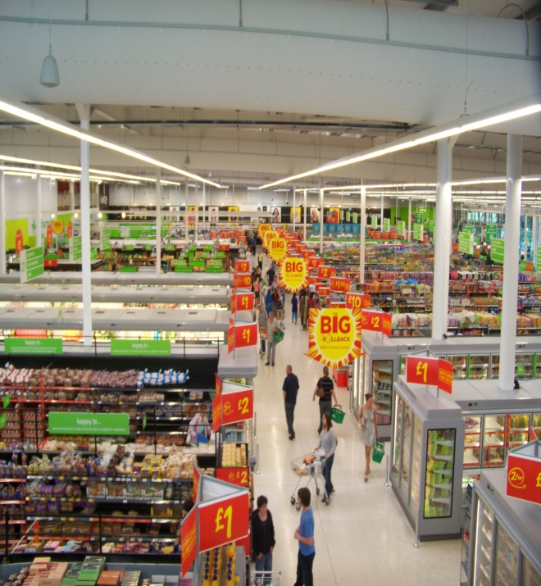
More goods & services
Specialization (theory of comparative advantage)
Specialization increases productivity

Slide 31
Theory of comparative advantage
2 individuals: Bob & Ann - 2 goods: fish & bananas
Bob in 24 hrs:
10 fish or 10 bananas
Ann in 24 hrs:
30 fish or 10 bananas
Assumption: monotonic, transitive and convex preferences for Bob and Ann
1) Scenario: No trade
Bob: 5 f. and 5 b.
Total production: 20 f. and 10 b.
Ann: 15 f. and 5 b.
2) Scenario: Trade
Bob: 10 b.
Total production: 30 f. and 10 b.
Ann: 30 f.
Bob:1 banana has an opportunity cost of 1 fish
Ann:1 banana has an opportunity cost of 3 fish
1 b. for 2 f.
Keen on trading if he can have MORE than 1 fish by exchanging 1 banana
Keen on trading if she can have 1 banana for less than 3 fish exchanged
5 b. & 10 f.
Makes everyone more happy
5 b. & 20 f.

Slide 32
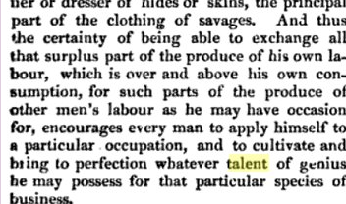
Adam Smith (The Wealth of Nations, chapter II)

Slide 33
Exam question (February 7th 2020)

Slide 34
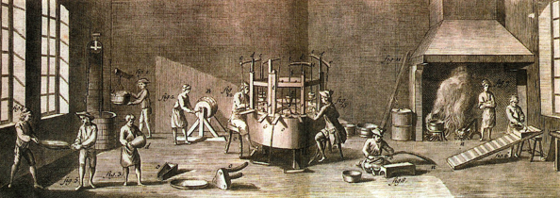
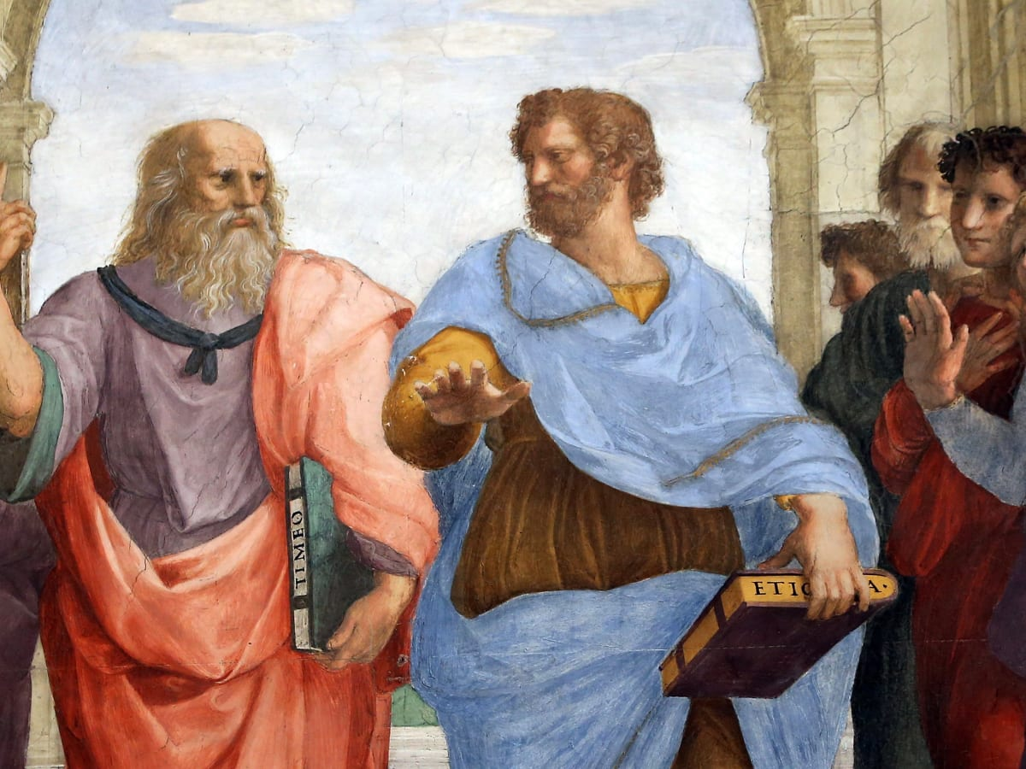
Wealth of nations (1776)
Since Adam Smith’s pin factory example we know that specialization increases productivity.
But the idea traces back to Plato (and his “Republic”) where in chapter II says: “….More things will be produced and the work more easily and better done, when every man is set free from all other occupations to do at the right time something for which is naturally fitted”.

Slide 35
Thus main message revised
Trade is (is even more) useful for welfare (also thanks and through to specialization).
But how to organize things in the whole economic system? How to decide on what we need to specialize (as a society) and who does what?

Slide 36

How to coordinate?
Productivity/
Specialization
Coordination
Information
How to gather all this relevant information and coordinate?
• A) centralized planning
• B) Markets enable autonomous decentralized decisions
Markets are costless mechanisms to achieve efficient allocations because PRICEs act as “information vehicles” by signaling scarcity
But this is 100% valid only if MARKETS ARE PERFECTLY COMPETITIVE: only in this case prices signal the true benefits and costs for the use of resources by the economic system.

Slide 37


On the “price signal” and market adjustments
26/02/2020
27/02/2020

Slide 38
Best general economic equilibrium possible
Industry i
Industry j
Supply of resources and products
Firm
Competitive markets for inputs and outputs
Firm
Firm
Firm
Firm
Demand of products and resources (materials, capital goods, services, investment ...)
Firm
Firm
Firm
Firm
Firm
Supply of resources (labour, land, savings ...)
Competitive markets of outputs
Competitive markets for inputs
Demand for products (goods and services)
Supply of products
Demand for resources
Household
Household
Household
Household
Household

Slide 39


From a social welfare perspective, competitive markets are the ultimate goal
Perfect competition
4 main “market imperfections”
- Market power
- Externalities
- Asymmetric information
- Transaction costs

Slide 40
References
Milgrom and Roberts (Economics, Organization and Management, chapter 2, pp. 19-28).
Further reading:
Varian, Intermediate Microeconomics, chap. “Exchange”, for Edgeworth box)
Samuelson and Nordhaus, Microeconomics, chapter on “Markets and Economic Efficiency”)
Seminal paper: Hayek, The Use of Knowledge in Society, American Economic Review, Vol. 35, No. 4 (Sep., 1945), pp. 519-530

